Slide 1
Yang, J. H., et al. Loss of epigenetic information as a cause of mammalian aging. Cell, 186(2), 305–326.e27.
Review by Matthew Suderman
IEU Molecular Epidemiology Meeting
Jan 24, 2023

Slide 2
Aging
Cellular identity and function change with age
What is driving aging?
Hardware breakdown – irreversible changes to DNA sequence
Software breakdown – reversible changes to gene expression and chromatin
Evidence against DNA damage
Individuals with more mutations don’t faster aging
Cloned mammals don’t age faster
Evidence for epigenetic changes
Overexpress SIR2 histones in yeast → extend lifespan
DNA methylation is the strongest biomarker of chronological age

Slide 3
Hypothesis
"aging in eukaryotes is due to the loss of transcriptional networks and epigenetic information over time, driven by a conserved mechanism that evolved to co-regulate responses to cellular damage, such as a DSB or a crush injury"

Slide 4
Aim
Create a mouse model with
Increased rate of double-strand DNA breaks
But similar mutation rate
Ask if this mouse
Ages faster than similar controls
Aging can be reversed by epigenetic reprogramming

Slide 5
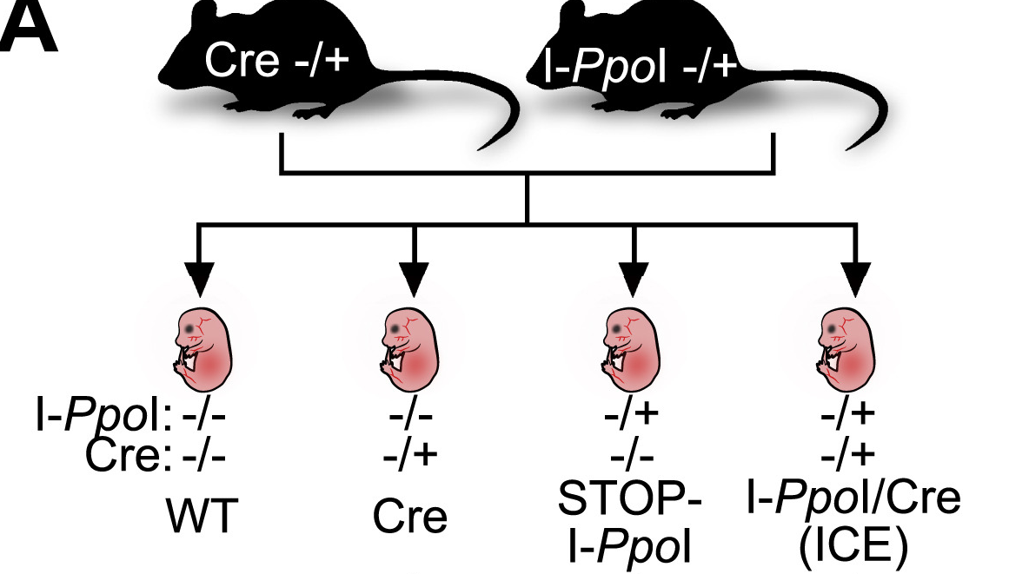

Mouse with more double-strand breaks
In ICE mice, tamoxifen treatment induces expression of ERT2-I-PpoI which cuts DNA at CTCTCTTAAGGTAGC motifs:
...ACGTTCCTCTCTTAAGGTAGCTCACAAT...​
...TGCAAGGAGAGAATTCCATCGAGTGTTA...
ICE
...ACGTTCCTCTCTTAA GGTAGCTCACAAT...​
...TGCAAGGAGAG AATTCCATCGAGTGTTA...
controls

Slide 6
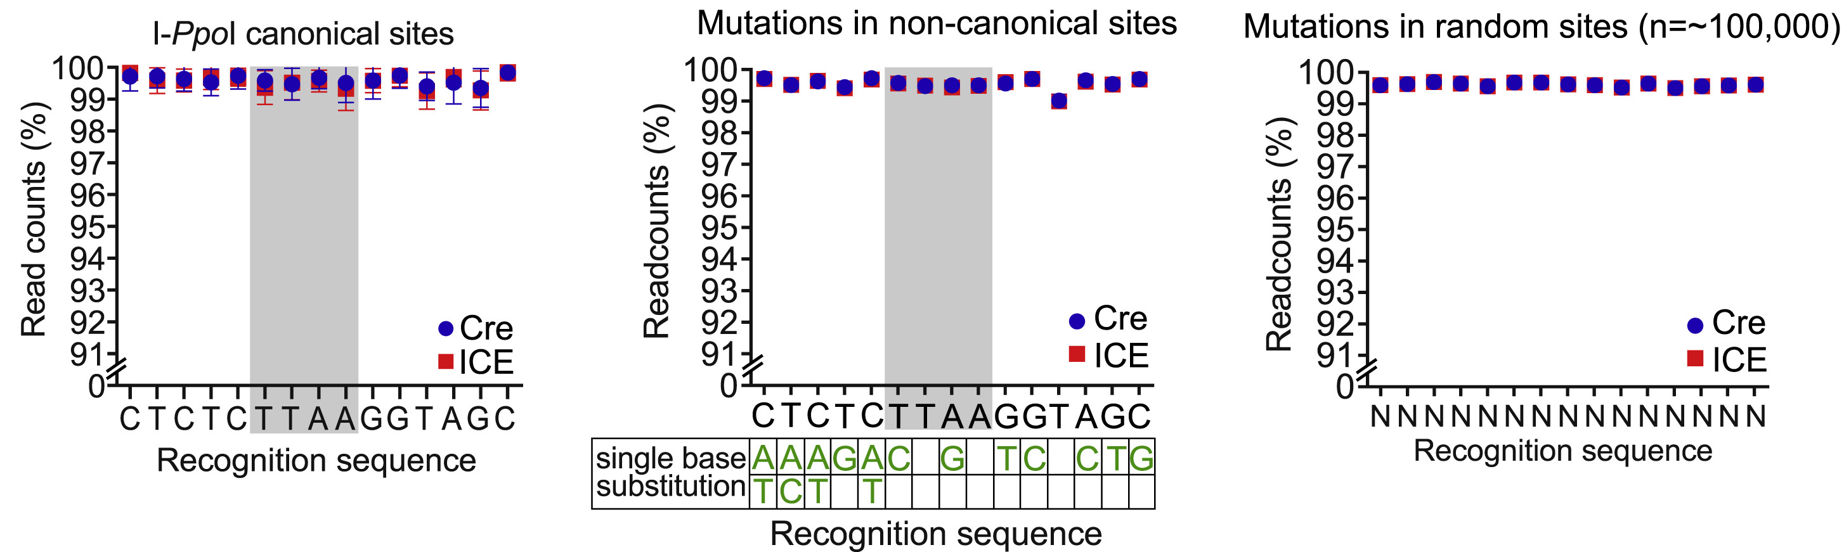
ICE mice have similar mutation rates
Treat mice with tamoxifen for 3 weeks at 4-6 months of age.
Count mutations in muscle 1 month after treatment
('Non-canonical' sites have sequence similar to the
CTCTCTTAAGGTAGC motif but include a few mismatches)

Slide 7
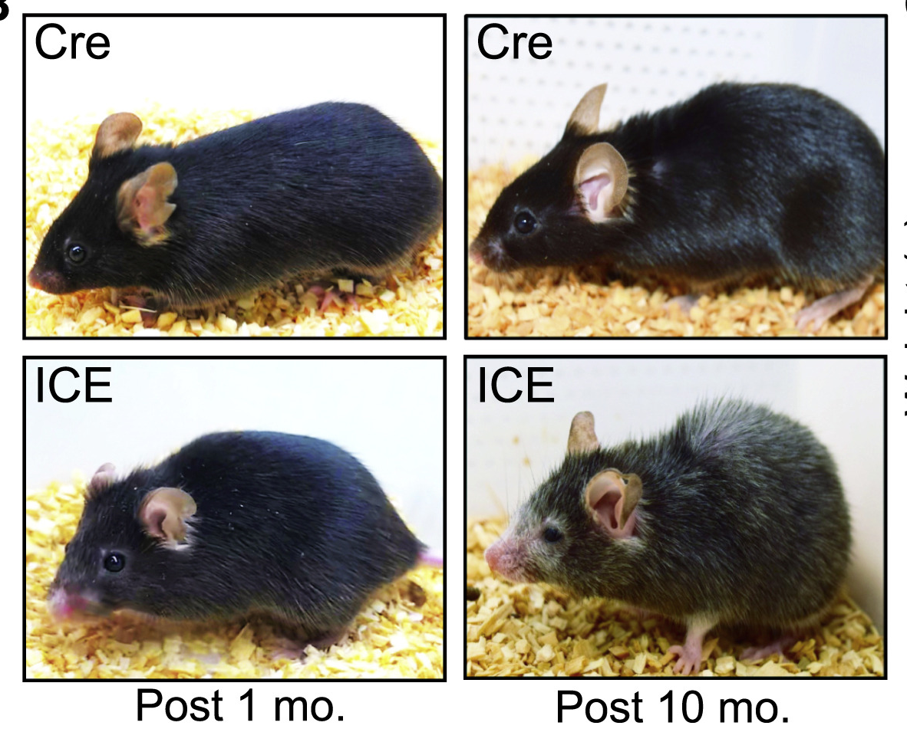
ICE mice exhibit aging phenotypes
10 months after treatment
Reduced body weight and fat mass
Lower daytime respiratory exchange ratio
Frailty index of controls 1.5x older
Spine curvature
Loss of bone density and thickness
Older kidney cell composition
Thinner skin
Hair graying

Slide 8
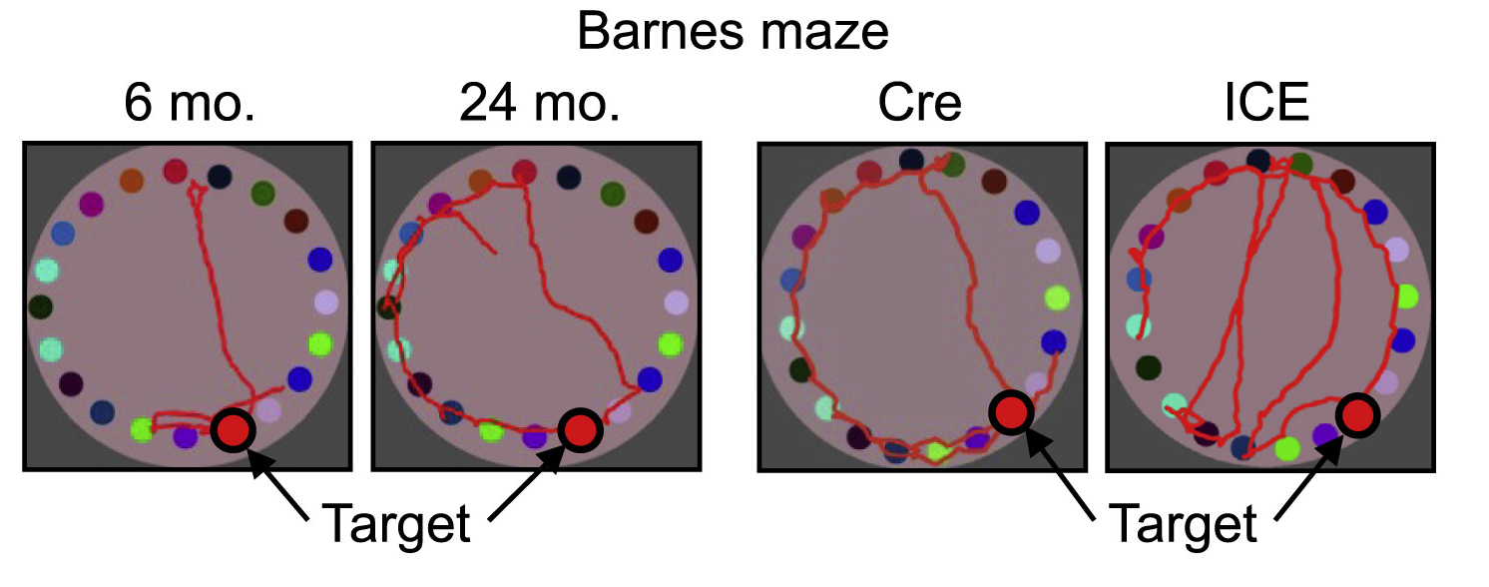
Brain aging
Moved 50% less in the dark phase
Impaired gait
Fear-conditioned recall like mice 1.5x older
Barnes maze recall 50% poorer
1.6x more activated astrocytes in hippocampus
3.5x more activated microglia in hippocampus

Slide 9
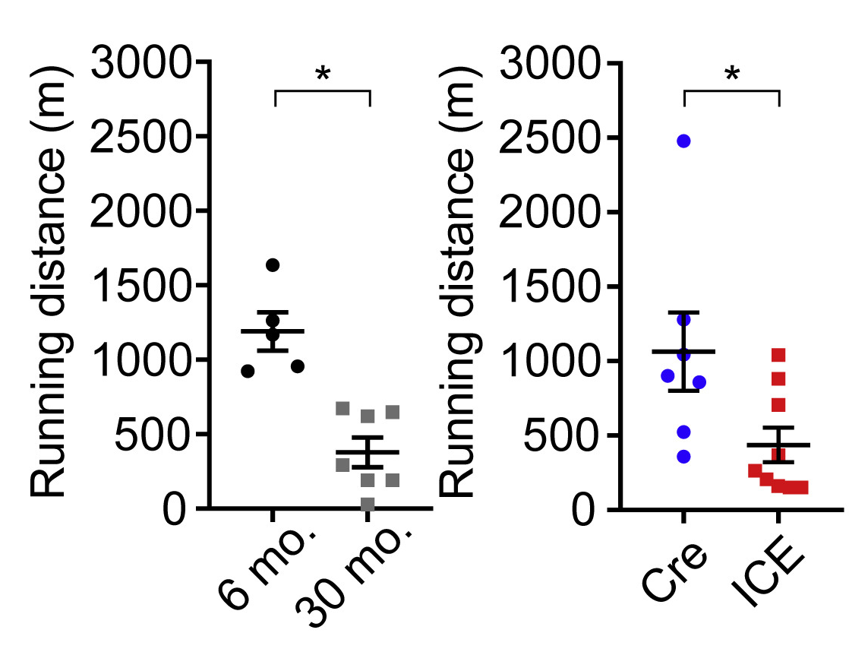
Muscle aging
less muscle mass
reduced endurance
greater lactate levels post-exercise
reduced grip strength
6-fold fewer cytochrome oxidase (COX)-positive myofibers
half the capillary to fiber ratio
thinner left ventricular (LV) posterior walls

Slide 10
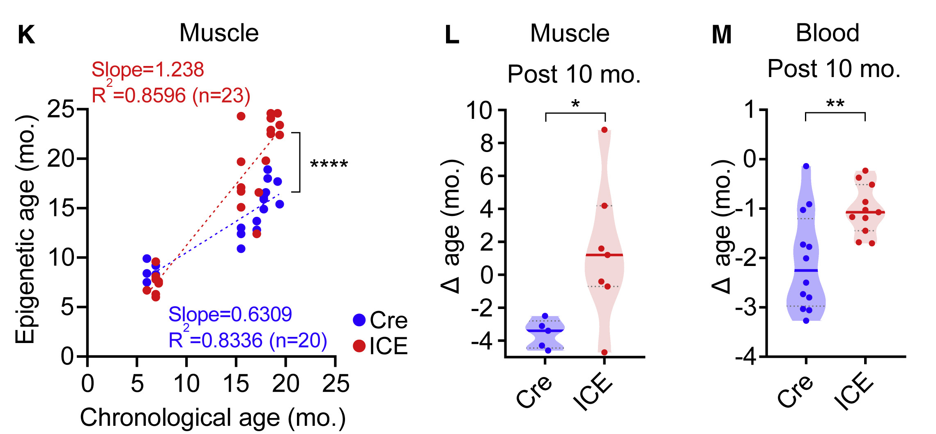
Epigenetic aging

Slide 11
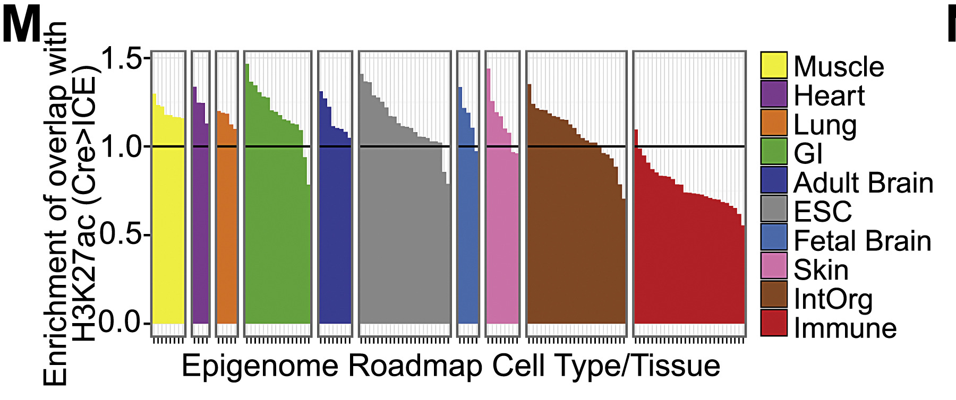
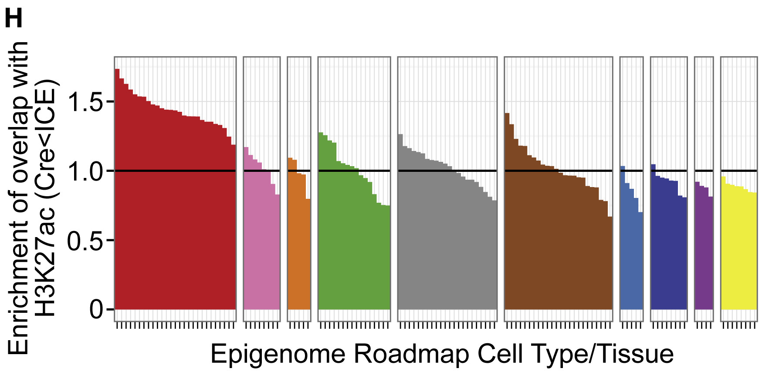
Cellular identity changes in ICE mice
Genomic regions where ICE skeletal muscle has less H3K27ac are best explained by enhancers in muscle cells.
Genomic regions where ICE skeletal muscle has more H3K27ac are best explained by enhancers in immune cells.

Slide 12
Reversing age in ICE mice
Background
Yamanaka factors Oct4, Sox2 and Klf4 (OSK) are highly expressed in embryonic stem cells
Over-expression of OSK induces pluripotency ('epigenetic reprogramming')
Experiment
Deliver OSK to ICE mice via adeno-associated virus

Slide 13
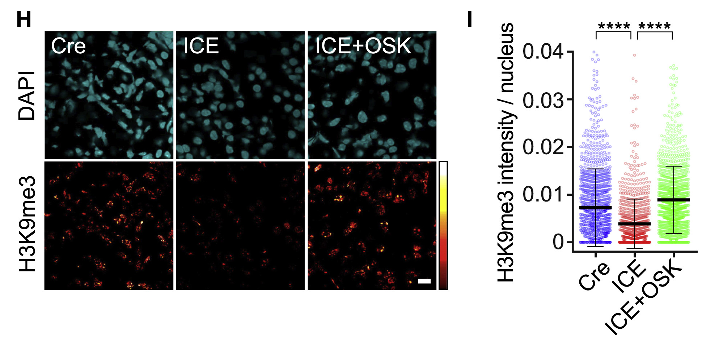
OSK reverses epigenetic aging in kidney

Slide 14
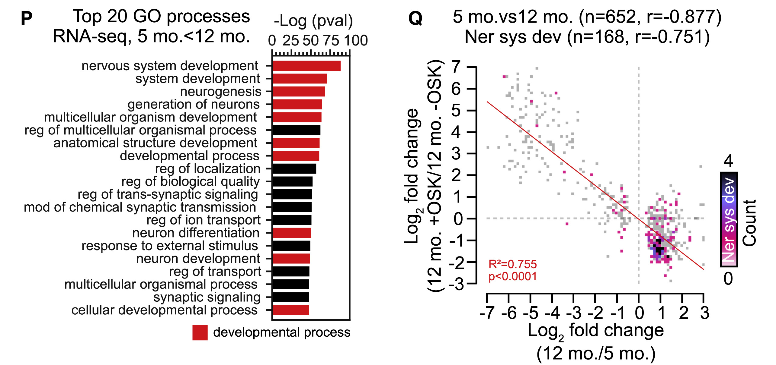
OSK reverses age-related expression of developmental genes
retinal ganglion cells

Slide 15
Conclusions
A little optimistic?
"Fortunately, it is now apparent that mammals retain a back-up copy of youthful epigenetic information that can safely restore the function of old tissues, akin to reinstalling software."
Double-stranded DNA breaks and repair
"erode the epigenetic landscape"
causing accelerate aging
independently of mutations
Aging can be reversed
by epigenetic reprogramming (to some extent)
via over-expression of OSK (but seems somewhat blunt)

Slide 16
Questions
Is there a reprogramming tool less blunt than OSK? It's one thing to say that epigenetic changes are reversible, but this seems complicated, e.g. reversible to what time point?
The authors say that mutations can 'mimic' aging. What does this mean?
Are double-stranded break the main cause of aging?
Why is epigenetic repair following DNA repair so poor?

